Slide 1
Source Code for User Stories

Slide 2
Github Repository
https://github.com/Team-3-MarketplaceSolution/DonationPlaceSolution

Slide 3
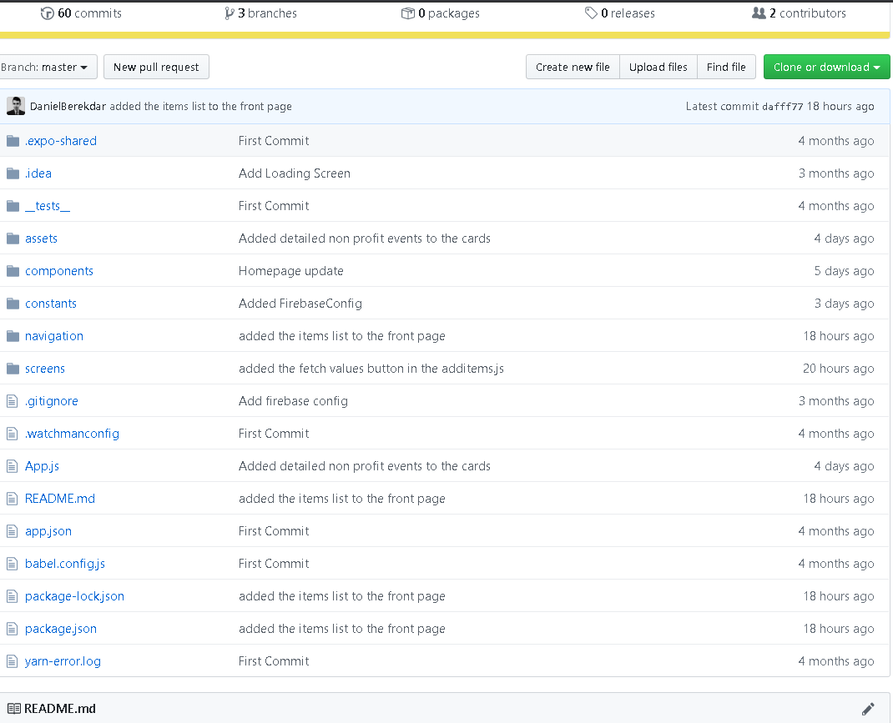

Slide 4
3.3 Get Shipping Information
import React, {Component} from 'react';
import { View, Text, TextInput, TouchableOpacity,StyleSheet, Button, Image} from 'react-native';
export default class ShippingInfo extends React.Component {
state = {
}
render(){
return (
<View style={styles.container}>
<Text>Your current tracking number is: 1Z94125299 </Text>
<Text>Please print and visit your local FEDEX with this label</Text>
<Text>The staff will assit you in shipping the package</Text>
<Text>
</Text>
<Image
source = {require('../assets/images/ShipmentLabel.jpg')}
style={{ height: 500, width: 350, flex: 1}}
/>
</View>
);
}
}
const styles = StyleSheet.create({
container: {
flex: 1,
justifyContent: 'center',
alignItems: 'center',
backgroundColor: 'white',
},
Text: {
borderBottomColor: "#8A8F9E",
width: '80%',
borderBottomWidth: StyleSheet.hairlineWidth,
height: 40,
fontSize: 22,
color: "#161F3D",
marginTop: 10
},
Image: {
width: 250,
height: 500,
flex: 1,
}
});

